Slide 1
Measures of Centre and Spread 2
EQ – Describe how to calculate measures of centre and spread for data given in a frequency table?

Slide 2
Learning Objectives
Understand that large data sets can be represented in a frequency table
To be able to calculate the mean, median, mode and range for data in a frequency table.

Slide 3
Measures of Centre and Spread 2 EQ – Describe how to calculate measures of centre and spread for data given in a frequency table?
W I C O R
Task:
Write a summary for last lesson
What are the three measures of centre for a data set?
What an advantage of using a census?
Why do you use a frequency table to represent a data set?
A local soccer club is surveying its players. The survey aims to be representative of the genders in the club. There are three times as many boys as girls in the club. Which of the following samples would get the most representative results?

Slide 4
W I C O R
Measures of Centre and Spread 2 EQ – Describe how to calculate measures of centre and spread for data given in a frequency table?
What is a frequency table?
Is used to summarise a data set
Example: 1, 1, 1, 1, 2, 2, 2, 2, 3, 3, 4
Score (x) | Frequecy (f)
1 | 4
2 | 4
3 | 2
4 | 1
Total | 11

Slide 5
W I C O R
Measures of Centre and Spread 2 EQ – Describe how to calculate measures of centre and spread for data given in a frequency table?
What is a frequency table?
How do I find the range?
Is used to summarise a data set
Example: 1, 1, 1, 1, 2, 2, 2, 2, 3, 3, 4
Score (x) | Frequecy (f)
1 | 4
2 | 4
3 | 2
4 | 1
Total | 11

Slide 6

W I C O R
Measures of Centre and Spread 2 EQ – Describe how to calculate measures of centre and spread for data given in a frequency table?
What is a frequency table?
How do I find the range?
Is used to summarise a data set
The difference between the smallest score ad the largest score
Example: 1, 1, 1, 1, 2, 2, 2, 2, 3, 3, 4
Score (x) | Frequecy (f)
1 | 4
2 | 4
3 | 2
4 | 1
Total | 11
Smallest
Largest
Range = $4−1=3$

Slide 7
W I C O R
Measures of Centre and Spread 2 EQ – Describe how to calculate measures of centre and spread for data given in a frequency table?
What is a frequency table?
How do I find the range?
How do I find the mode?
Is used to summarise a data set
The difference between the smallest score ad the largest score
The score with the highest frequency
Example: 1, 1, 1, 1, 2, 2, 2, 2, 3, 3, 4
Score (x) | Frequecy (f)
1 | 4
2 | 4
3 | 2
4 | 1
Total | 11
Smallest
Largest
Range = $4−1=3$

Slide 8

W I C O R
Measures of Centre and Spread 2 EQ – Describe how to calculate measures of centre and spread for data given in a frequency table?
What is a frequency table?
How do I find the range?
How do I find the mode?
Is used to summarise a data set
The difference between the smallest score ad the largest score
The score with the highest frequency
Example: 1, 1, 1, 1, 2, 2, 2, 2, 3, 3, 4
Score (x) | Frequecy (f)
1 | 4
2 | 4
3 | 2
4 | 1
Total | 11
Highest Frequency
Range = $4−1=3$
Mode 1 and 2 (bimodal)

Slide 9


W I C O R
Measures of Centre and Spread 2 EQ – Describe how to calculate measures of centre and spread for data given in a frequency table?
What is a frequency table?
How do I find the range?
How do I find the mode?
How do I find the median?
Is used to summarise a data set
The difference between the smallest score ad the largest score
The score with the highest frequency
If there are $n$ scores then the median is the $\frac{n+1}{2}$^{th} score.
Example: 1, 1, 1, 1, 2, 2, 2, 2, 3, 3, 4
Score (x) | Frequecy (f) | Cumulative Frequency
1 | 4 | 4
2 | 4 | 8
3 | 2 | 10
4 | 1 | 11
Total | 11 | 11
Range = $4−1=3$
Mode 1 and 2 (bimodal)
There are 11 scores
so the median is $\frac{11+1}{2}=6$^{th} score which is 2.

Slide 10
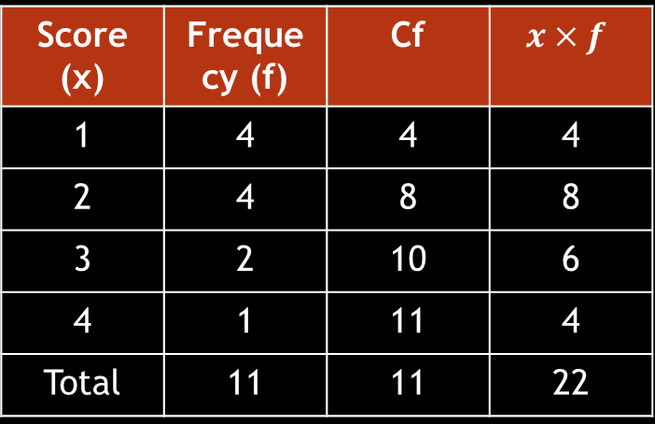



W I C O R
Measures of Centre and Spread 2 EQ – Describe how to calculate measures of centre and spread for data given in a frequency table?
What is a frequency table?
How do I find the range?
How do I find the mode?
How do I find the median?
How do I find the mean?
Is used to summarise a data set
The difference between the smallest score ad the largest score
The score with the highest frequency
If there are $n$ scores then the median is the $\frac{n+1}{2}$^{th} score.
Example: 1, 1, 1, 1, 2, 2, 2, 2, 3, 3, 4
Score (x) | Frequecy (f) | Cf | $$x×f$$
1 | 4 | 4 | 4
2 | 4 | 8 | 8
3 | 2 | 10 | 6
4 | 1 | 11 | 4
Total | 11 | 11 | 22
Range = $4−1=3$
Mode 1 and 2 (bimodal)
There are 11 scores, so the median is $\frac{11+1}{2}=6$^{th} score which is 2.
Mean $=\frac{22}{2}=2$
$$Mean=\frac{sum of (score ×frequency)}{Total frequency}$$

Slide 11
W I C O R
We do -
Find the mean, median, mode and range for the data set below
Mode –
Range –
Median –
Mean -

Slide 12
W I C O R
We do -
Find the mean, median, mode and range for the data set below
Mode – 2
Range – 3
Median – 2
Mean – 1.72

Slide 13
W I C O R
You do -
Find the mean, median, mode and range for the data set below
Mode –
Range –
Median –
Mean -

Slide 14
W I C O R
You do -
Find the mean, median, mode and range for the data set below
Mode – a) 2, b) 2, c) 20, d) 2, e) 14, f) 20
Range – a) 3, b) 3, c) 30, d) 4, e)4, f) 40
Median –
Mean -

Slide 15
Plenary
W I C O R
In pairs – Decide who will be person A and who will be person B.
Person A – describe to person B how to calculate the median from a frequency table
Person B – describe to person A how to calculate the mean from a frequency table

